Slide 1
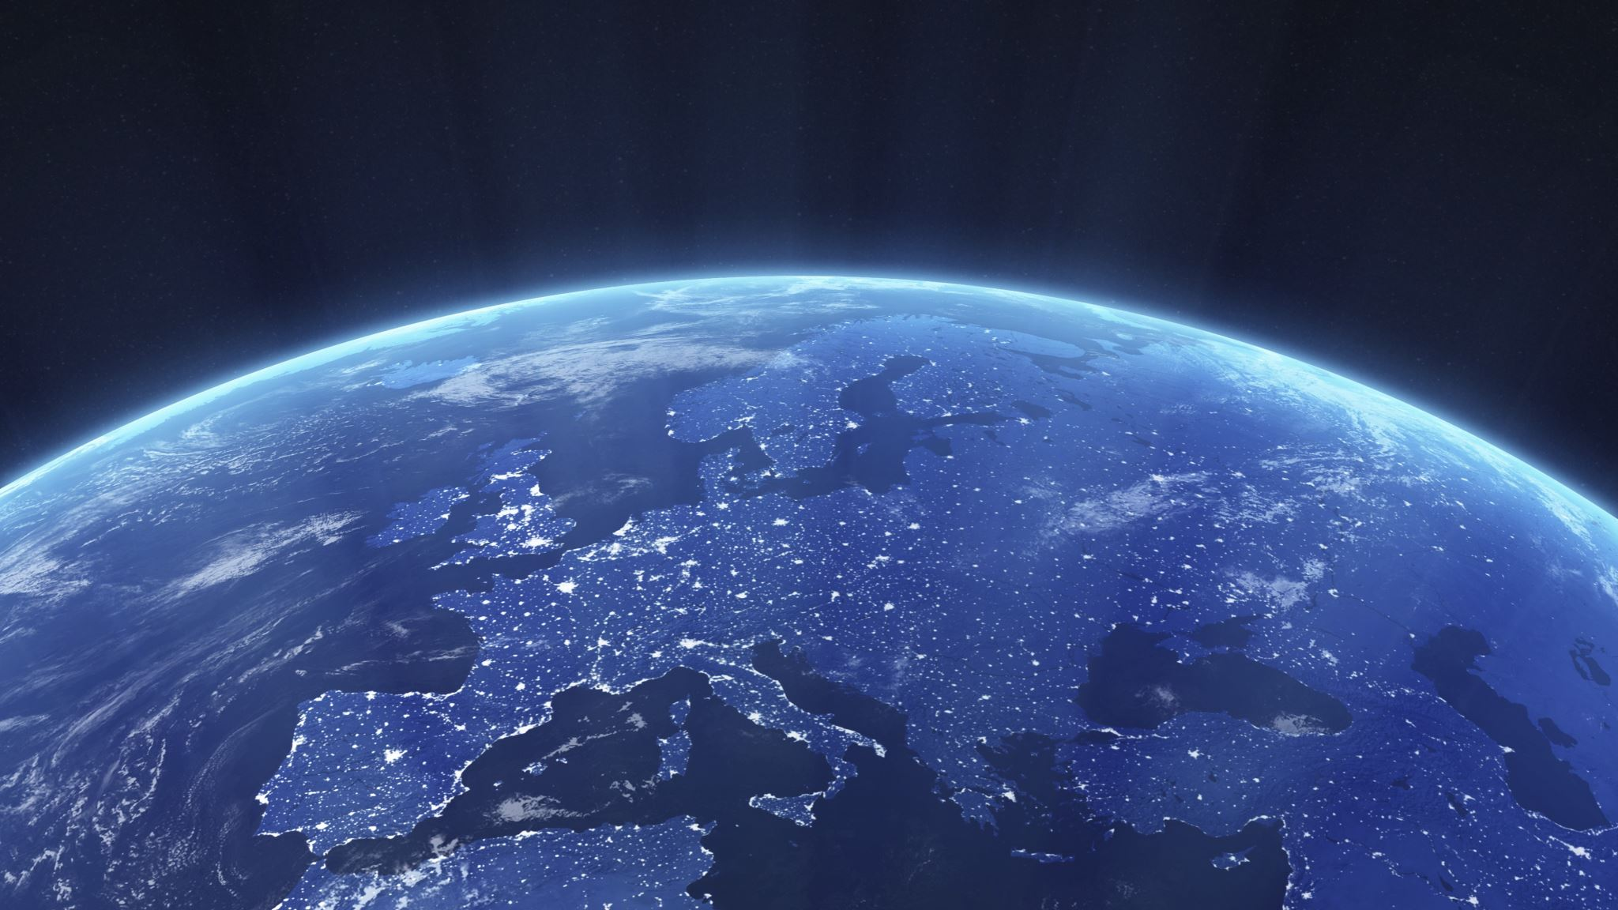
Convective Cloud Extraction from INSAT-3d sat data
By 17IT098 – Arjun Rupavatia
Industry : ISRO (SAC)

Slide 2
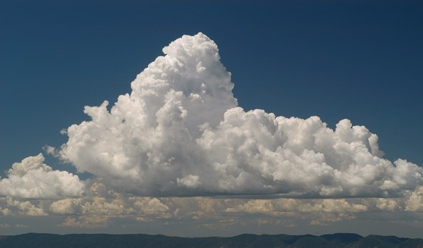
CONVECTIVE CLOUDS:
Specific types of dense clouds formed when warm humid air rises through cooler surrounding air in the atmosphere
CONVECTIVE clouds detection and early warning is an important part of modern weather forecasting. They usually cause severe weather such as strong wind, hail, thunder and lightning, and heavy rainfall.

Slide 3
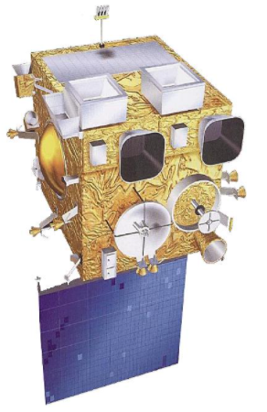
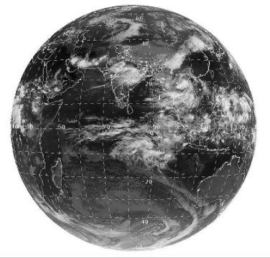
INSAT-3D:
A meteorological, data collection satellite of ISRO to provide an operational, environmental & storm warning system to protect life & property and also to monitor earth’s surface and carryout oceanic observations and also provide data dissemination capabilities.

Slide 4
OUTLINE
Tools and Technology
Dataset
Data Transformation
Architecture
Functional Requirement
Motivation
Learning Outcome
Further Planning

Slide 5
TOOLS AND TECHNOLOGIES
Deep Learning : 1x1 conv network, Double-Stream network
HDFViewer to understand H5 files
INSAT-3Dsat for dataset
Python for implementing (Jupyter platform)

Slide 6
Dataset
Dataset is provided on request by INSAT-3D satellite.
Data is of hierarchical format H5
Dataset consists of various layers to be applied on grid generated on selected region at particular time.

Slide 7
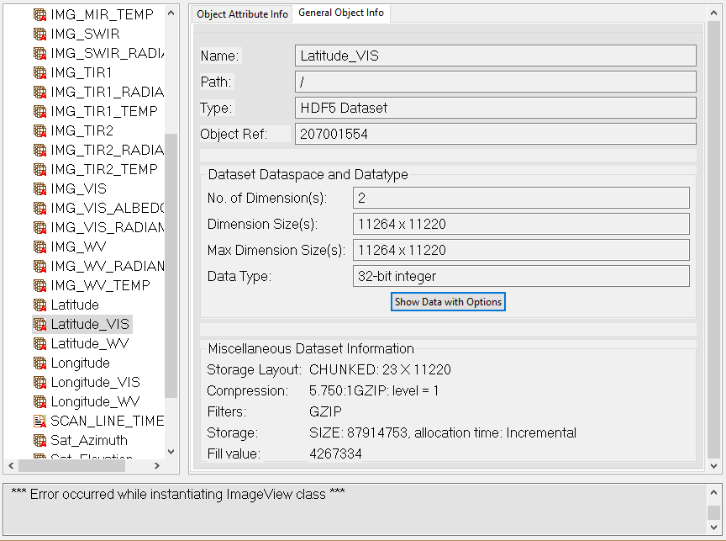

Slide 8
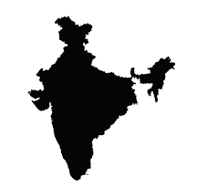

Slide 9
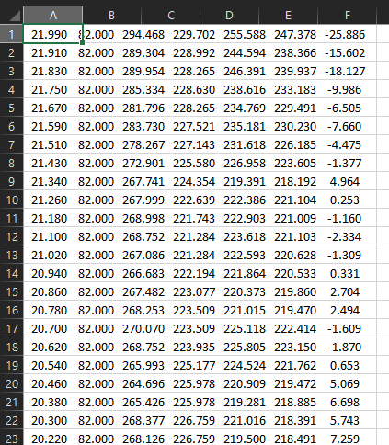
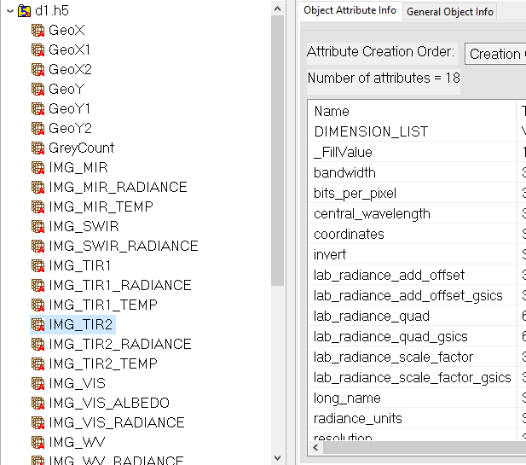
Data Transformation

Slide 10
FUNCTIONAL REQUIREMENTS
Efficient extraction of Spectral features influencing our model
Accurately segmenting convective clouds based on spectral and spatial features
Spatial features must not effect Spectral features.

Slide 11
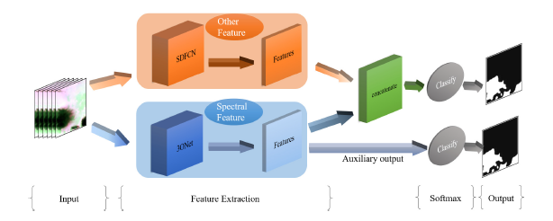
ARCHITECTURE OF MODEL

Slide 12
Data Pre-processing
Channel 1
Channel 1
Channel 2
Channel 2
Channel 3
Channel 3
Channel 4
Channel 4
Channel 5
Channel 5
51*183*5

Slide 13
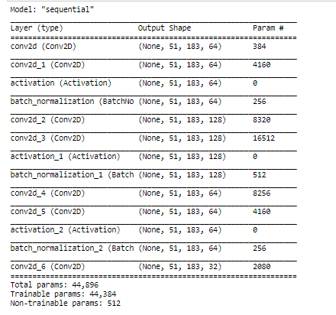
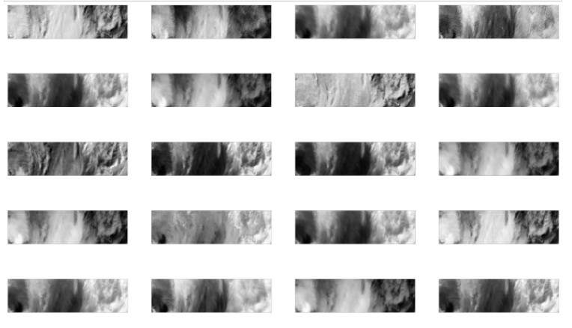
Implementing 3ONet
Spatial feature Maps

Slide 14
MOTIVATION
ISRO is a leading organization in space innovations and research. I was proposed with an opportunity to be a part of such organization and so far it has been as per my expectations.
Also, I got an opportunity to work in the domain of my interest and it was a great opportunity to work on live data from satellite. Also ISRO being sensitive to its privacy, it follows some best practices to ensure security and it was a great opportunity to work in such environment.

Slide 15
LEARNING OUTCOME
So far, I studied various research papers and understood how Machine Learning and Deep Learning can be used in Weather Forecasting, Weather Now-Casting and on multi-channel prediction. Also I learned about the data formats used and obtained from satellite and how to manipulate them. Learned various models and their limitations and analysed best possible model to be implemented. Learned various data input formations accepted by different models and specifically extracting only feature maps from proposed model.

Slide 16
FURTHER PLANNING
Working on implementing other part of double stream network and concatenating both models to form final output results.

